Slide 1

Sesamm Tool v2 Software Architecture Document

Slide 2

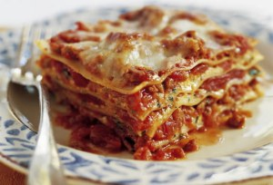
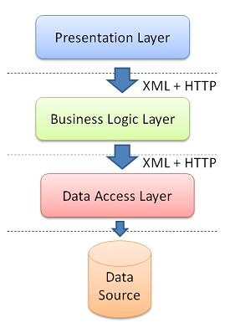
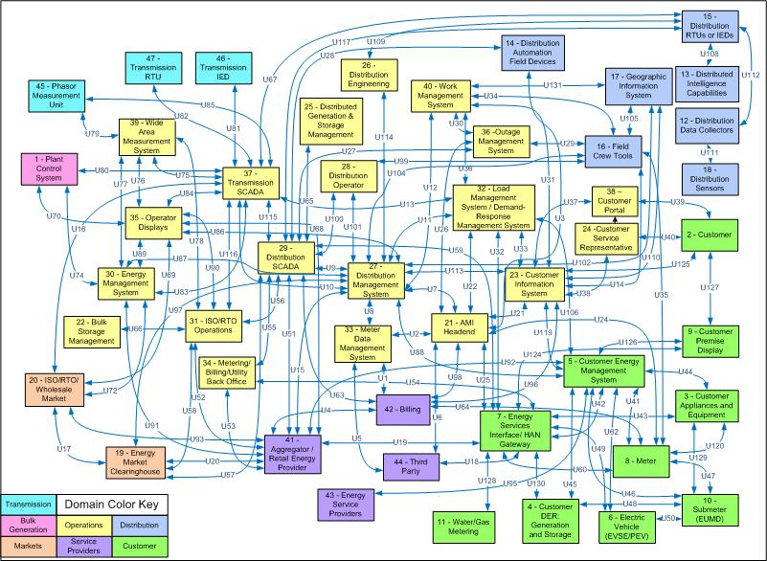
Vision
Spaghetti code
Lasagne code

Slide 3
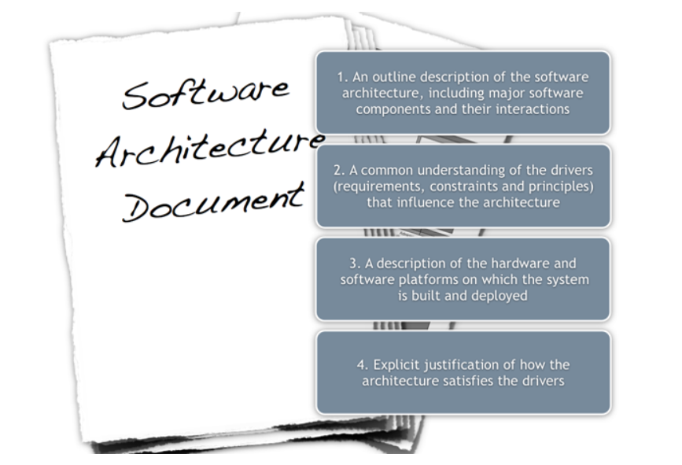
What is a Software Architecture Document?
http://en.wikipedia.org/wiki/Software_architecture

Slide 4
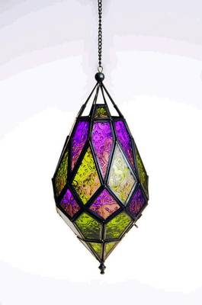
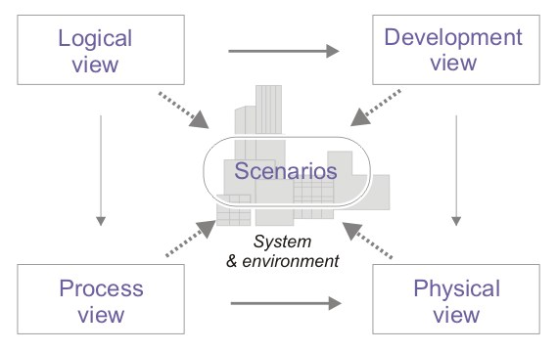
The 4+1 Framework!
Document is based on viewpoints
Each viewpoint gives the reader a new perspective of the system.

Slide 5
Software Architecture Views
The Scenario/Use case View describes the major business processes and high level Use cases that the system will support. This view is placed in the center of the 4+1 model and gives the reader an understanding of the domain that the system will support.
The Logical View describes how the software is decomposed into layers, packages and subsystems. It will also define the interfaces between the different parts of the software.
The Development View is used to describe the routines when compiling and building the system. The view will also contain information regarding source control and system configuration.
The Physical View shows the hardware layout of the system. It also describes how the processes of the process view are mapped onto the physical nodes of the system.
The Process View describes the major applications, i.e. web sites, windows services, schedule tasks, that is used within the system. The name “Process view” refers in this document to the system processes, not the business processes.
Additional views
The Data View describes the persistent data storage perspective of the system. This view contains the major database schemas, the fail-over mechanism that is used at system failure and lots of more interesting stuff.
The Principle View describes the different patterns and guidelines that should be used when designing and updating the system.

Slide 6
The Primary Use cases

Slide 7
Logical view 2018-10-25
Logical View
Views
ViewModels
WPF infrastructure
Presentation Layer
Validation
Analyze
Instance Model
Edit
JIRA Access
Cross cutting concerns:
Logging
Exception
…
Business Layer
SesammDataModel
Security
…
Data Layer
DB Access
DB Change
OAS Access
File Access
…

Slide 8
Development view
Principles of continuous integration

Slide 9

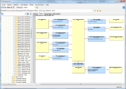




Development View
SesammTool 1
Production database
\\Sesoco3142\SESAMMDB
Microsoft SQL Server
SesammTool2 Users
ClickOnce installation and automatic update
Migration of database from ST1=>ST2
executed on schedule (every night)
Triggered from Jenkins
Shared Network folder
CRUD
x:\...
Development database
\\sesoco3268\ SesammTool2_alphaReadOnly
Microsoft SQL Server
Source code
Repository CI/CD
pipeline (GitLab)
ClickOnce Deployment
Jenkins Build/CI-server (http://resbuild)
Push Build artefacts
from Develop Branch
when committed
Get latest
SesammTool Developers
Check in
CRUD

Slide 10





Physical View
External integrations
(Read only)
Standard Scania PC
Laptop or Stationary
OAS
Jira
SesammTool application
.NET Windows Application
(installed and updated using ClickOnce)
Internal
Scania Network
Fetch function structure
information (Scheduled)
Fetch CR (SSCR) information
(Scheduled)
Windows Server
Shared Network folders
Cache
information
read from
external integrations
SESOCO3268
SesammTool2
x:\...
?:\...
PowerSesamm
PowerShell
CLI application
Scheduled
deliveries
(e.g. CanDb, ’Ys-delivery’, …
Microsoft SQL Server

Slide 11
Data View
CRUD operations against persisted data.
Data storage:
Relational database (SQL server)
File system
Perforce, JIRA, …
Microsoft Entity Framework is used for ORM-mapping (object relational model). It provides typed data classes and facilitates the implementation of CRUD operations.

Slide 12
Data View
Anchor modelling
Built-in version control.
Updates are not used.

Slide 13
Anchor modelling

Slide 14
Data view 2018-11-30
V
UF
V
FC
V
V
V
1
*
1
*
UC
1
*
SCN
TC
Functional
1
1
1
1
*
AED
*
V
1
V
V
ScnRel
UfRel
*
*
V
*
0..1
Any
Anchor
CR
*
1
V
*
AedLayout
(this is a table not based on EntityBase)
1
0..1
AE
AEP
PD
V
1
*
V
* (2 for DwPD)
1
1
Logical
*
*
One of
Excl.VD
*
V
V
Seg
1
*
CanPD
V
V
DwPD
IntPD
*
*
1
SA
DA
1
1
*
CompSegRel
*
V
*
1
CanMsgSig
V
*
*
1
0..1
*
*
Mux
VD
V
1
V
Source and maybe(If PDU1) Destination addr
1
Comp
V
*
*
1
1
1
1
1
0..1
MSG
SIG
V
*
V
V
1
1
Addr
Physical
CompCode
V
*
GW
V
*
*
From
To

Slide 15
Graph algorithm
To find dependencies between instances a graph and a special graph traversing algorithm is used
First a ”complete” graph covering the complete model is created
Not all Node-types found in Datamodel are included
Change requests, Value descriptions, Excluded Value descriptions, Mux and Component Segment relations are excluded. Component and ComponentCode is combined to one Node
Nodes are connected with Edges, each edge has an Identifer that (with some exceptions) are uniquely based on Type of Nodes where Edge start and end.
Edges have a defined direction, but can be traversed in both directions
To find Nodes related to a specific Node the algorithm uses that Node as start-point and traverse from that point until all possible paths has been traversed. All Nodes that has been traversed are considered ”related” to the start Node. A new ”filtered” graph is created in the process of traversing.
To find Nodes related to multiple Nodes the process is repeated with a new Start-Node in the ”filtered” Graph.
The algorithm has a rule that you can never traverse two edges with the same identifier to and from a node in the same path.

Slide 16
Graph Algorithm Datamodel 2018-11-05
V
UF
FC
V
V
V
A
B
UC
C
SCN
TC
1
*
1
*
1
*
*
P
*
V
*
A-Q = Edge Identifier
D
*
(Depends on AEP direction)
AE
AEP
PD
V
E
V
J(Tx) or K(Rx)
1
*
* (2 for DwPD)
1
1
*
H
H
H
(Inheritance)
V
J
GW
CanPD
V
V
From
K
*
DwPD
IntPD
To
SA
DA
Seg
Q
*
*
*
F
Same identifier to avoid getting false
relations between SA and DA
F
1
CanMsgSig
G
V
L
L
1
Seg
V
Same identifier to avoid getting false
relations between GW and AE
*
*
1
1
Source and maybe(If PDU1) Destination addr
N
M
Comp +
Code
V
1
1
1
0..1
V
SIG
MSG
V
V
Addr

Slide 17
AED database tables
See schema next slide
AED is a ”normal” Anchor with Versions and a relation to UF
The Version has in addition to Version-base defined properties (Name and Comment) also a reference (ForeignKey) to a non Entitybase table with aed-layouts as string in xml-format
From start is possible to get a relation from UF to AED without having to read the table with AED-layout information
AED-Instances can be created using the same schema as for other Instances
The Layout-xml can be read from database on demand
It is also possible to create ”link-tables” (and cache in memory) from xml in the background to get improved functions to locate AED’s from filters

Slide 18
AED Data view 2020-11-18
UF
AED
1
AedLayout
(this is a table not based on EntityBase)
V
1
*
V
0..1
1
1
Dashed lines are not database relations. It is only Key-references in the xml-”file”.
1
*
layout.xml
V
UfRel
*
Tx
AED_AE
AED_FV
*
0..1
*
*
0..1
Rx
0..1
1
*
*
AE
AEP
PD
V
1
*
V
* (2 for DwPD)
1
*
2(Rx, Tx)/Row
One of
CanPD
V
V
DwPD
IntPD
*
SA
DA
1
1
*
*
1
*
CanMsgSig
V
1
V
Seg
*
*
1
Source and maybe(If PDU1) Destination addr
Comp
1
V
MSG
1
V
1
0..1
SIG
V
V
*
Addr
1
1
0..~5/(Can)row
0 for NonCan
CompCode
V
*
GW
V
*
*
From
To

Slide 19
AED Add ”link” view 2020-11-18
UF
AED
1
AedLayout
(this is a table not based on EntityBase)
V
1
*
V
0..1
Dashed lines are not database relations. It is only Key-references in the xml-”file”.
1
1
1
*
layout.xml
Objects that must be possible to add or update when creating links in AEDs
The rest we could assume that they already exist
V
UfRel
XXX
V
*
Tx
AED_AE
AED_FV
*
0..1
*
*
0..1
Rx
0..1
1
*
*
AE
AEP
PD
V
1
*
V
* (2 for DwPD)
1
2(Rx, Tx)/row
One of
*
CanPD
V
V
DwPD
IntPD
*
SA
DA
1
1
*
*
1
*
CanMsgSig
V
1
V
Seg
*
*
1
Source and maybe(If PDU1) Destination addr
Comp
1
V
MSG
1
V
1
0..1
SIG
V
V
*
Addr
1
1
0..~5/(Can)row
0 for NonCan
CompCode
V
*
GW
V
*
*
From
To

Slide 20
AED Dataview Suggestion 2021-02-05
UF
V
AED
1
*
V
~AED (Including Layout)
New “Instances”
1
1
*
V
UfRel
*
*
Tx
AED_FV Incl. Pos.
AED_AE
Incl. Pos.
V
*
V
1
*
1
*
Rx
1
1
1
AE
AEP
PD
V
1
*
V
* (2 for DwPD)
1
*
Rejected at meeting 2021-02-05
*
1
1
AED_FV_ROW
One of
*
Tx
V
CanPD
V
V
Rx
DwPD
IntPD
*
*
1
SA
DA
1
1
*
*
1
*
CanMsgSig
V
1
V
Seg
[0..~5]
*
*
AED_GW_STEP
1
Source and maybe(If PDU1) Destination addr
Comp
1
V
*
MSG
1
V
1
0..1
SIG
V
V
*
Addr
1
1
CompCode
1
V
*
GW
V
*
*
From
To

